Slide 1



Human Computer Interaction
CalcBox
Project Presentation
Team Pals
Cuello - Monteverde - Ajias

Slide 2


Human Computer Interaction
Presentation Content
Motivation - The Whys
Identifying the Problem - The Hows
Prototype Design - The Looks
Evaluation - The Results
Conclusion - The Learnings

Slide 3


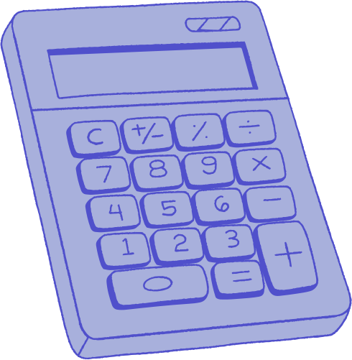
Human Computer Interaction
Why: The Motivation
What problem did we want to solve?
Many people often need calculators for more than just basic math, like for conversions, financial calculations, or scientific formulas. But most calculators, especially mobile ones, don’t include these built-in. Users end up searching online or using multiple apps, which wastes time and can be frustrating at some point. We wanted to solve this by creating one easy-to-use app that brings all these calculators together in one place, while also letting users personalize the app to fit their needs.

Slide 4



Human Computer Interaction
We noticed that many people often search the internet just to find formulas or use online calculators for things like physics problems, currency conversions, or interest computations. This shows that current calculator apps don’t meet their needs especially for those who don’t remember formulas offhand. Relying on external websites takes extra time and can be frustrating, which proves there’s a gap in existing calculator tools. This common experience made it clear that users need a more complete and convenient solution built into one app.
How: Identifying the Problem
How did we identify the problem?

Slide 5
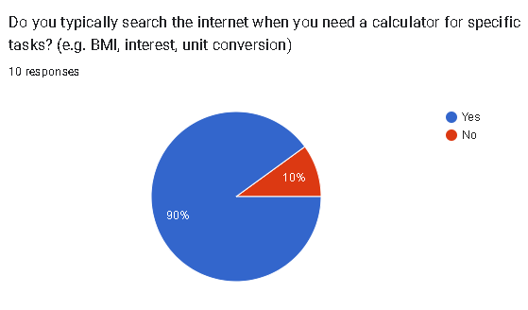
Human Computer Interaction
This partly shows a clear need for an all-in-one, easy-to-use calculator app. Many users still rely on searching online for formulas or tools, which can be time-consuming. Our survey result helped confirm that there’s a real problem our app can solve by making commonly used calculators and formulas more accessible, organized, and customizable in one place.

Slide 6
Human Computer Interaction
CalcBox
What’s CalcBox?
CalcBox is a multi-functional mobile application designed to consolidate a wide range of calculators and converters into a single, easy-to-use platform. It includes number base converters, scientific calculators, unit converters, interest calculators, and more organized in a customizable tile grid interface. Users can personalize the app experience by selecting visible calculators and customizing its appearance. The goal of the project is to improve productivity by minimizing the need to switch between multiple websites and calculator apps, thereby enhancing user convenience and accessibility.

Slide 7

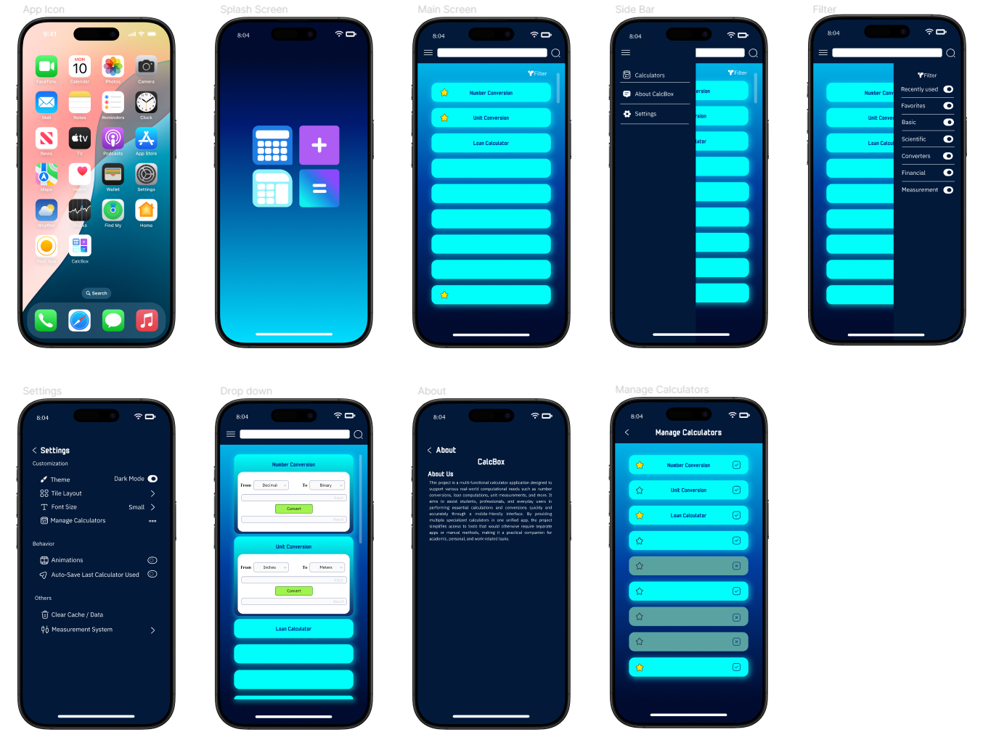
Human Computer Interaction
Prototype Design

Slide 8

Human Computer Interaction
Prototype Design
COLORS
FIGMA
The prototype was built using Figma, a cloud-based design and prototyping platform. Figma enabled Figma enabled real-time collaboration, allowing the team to work together seamlessly throughout the design process.
#00FFFB
#002651
#2a7dd8

Slide 9





Human Computer Interaction
Dynamically Rendered Calculator Tiles
FEATURES
Enable/Disable Specific Calculators
WHAT CAN IT DO?
Customization Settings
Search Specific Calculators
Testing and Usability

Slide 10

Human Computer Interaction
Evaluation Plan
PREPARE
Prepare our evaluation by designing a survey and usability test to gather both quantitative ratings and qualitative feedback on key aspects like ease of use, navigation, and visual design.
LAUNCH
Launchthe evaluation by distributing the survey and allowing users to interact with the app prototype, asking them to complete specific tasks such as locating and using a particular calculator and input their feedbacks regarding usability and satisfaction.
EVALUATE
We collect and summarize the responses, including Likert scale ratings and open-ended feedback, to assess how well the app performed in terms of usability, accuracy, and user satisfaction.
DISCUSS
We analyze the data to identify patterns, strengths, and areas for improvement such as the app being easy to use but with suggestions for clearer labels or added features like calculator history.
CONCLUDE
We will conclude our evaluation by identifying key takeaways and determining whether our current design meets user needs. Based on the findings, we will plan necessary updates and improvements for the app.

Slide 11
Human Computer Interaction
METHODS OF EVALUATION
USABILITY SPECIFICATIONS
Participants will be given tasks and time to determine the usability of the application.
Exploration Tasks
Calculator Tasks
Settings Tasks
HEURISTICS EVALUATION
The application will be examined based on standard usability principles to identify potential design flaws.
SURVEY AND FEEDBACK
Users will answer a post-test survey to share their experience, satisfaction, and suggestions.

Slide 12

Human Computer Interaction
USABILITY SPECIFICATIONS
1.09 min
3.24 min
2.49 min
Exploration Tasks
Calculator Tasks
Settings Tasks
Participants were able to explore and navigate through the prototype with ease. The fast completion time indicates a smooth and intuitive interface, especially for first-time users.
Users were able to interact with various calculators quickly and accurately. This shows that the core function of the application was straightforward and user-friendly.
Users managed to adjust preferences in the settings panel efficiently. This suggests that personalization options were clear and accessible within the time limit.

Slide 13
Human Computer Interaction
HEURISTICS EVALUATION
Overall, the prototype successfully adhered to most of the usability heuristics, receiving mostly scores of 4 and 5 across all criteria. Areas such as Match Between the System and the Real World, Consistency and Standards, and Recognition Rather Than Recall stood out with consistently high ratings, indicating that users found the interface intuitive, consistent, and easy to recognize.
However, one area that may still need further refinement is Error Prevention, which received a slightly lower score (3) in one instance. This suggests that while the system has some preventative features in place, improvements can still be made to ensure users avoid common mistakes more effectively.

Slide 14

Human Computer Interaction
SURVEY AND FEEDBACK
4.92
Average Mean of the
Survey Questions
The survey result shows that the prototype is at an
Acceptable Interpretation. This means that the
prototype is successful in terms of design and usability.

Slide 15
Human Computer Interaction
SURVEY AND FEEDBACK
FEEDBACK 1
FEEDBACK 2
FEEDBACK 3
Some users mentioned that a few calculators were unfamiliar.
It was suggested to add brief descriptions explaining what each calculator is for.
While the interface was generally praised, one suggestion was to improve the visual design to make it more appealing.
A few users requested the addition of shortcut keys and
history tracking features for ease of access and reviewing previous calculations.

Slide 16
Human Computer Interaction
Conclusion
From our user feedback, we concluded that the app performs very well in terms of usability and user satisfaction. Most users rated all key aspects highly, especially ease of use, accuracy, and customization options. The results confirmed that CalcBox successfully reduces the need to search for multiple calculators online, fulfilling its goal of centralizing a wide variety of calculators into a single, intuitive platform. Although some users mentioned minor improvements like enhancing visual design or adding descriptions for lesser-known calculators, the overall feedback was positive, and no critical usability issues or functional errors were reported.

Slide 17

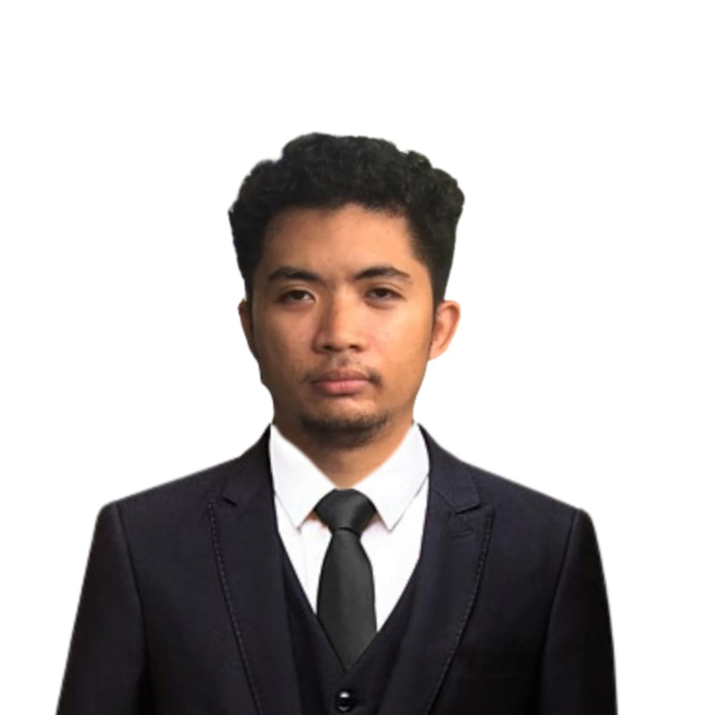
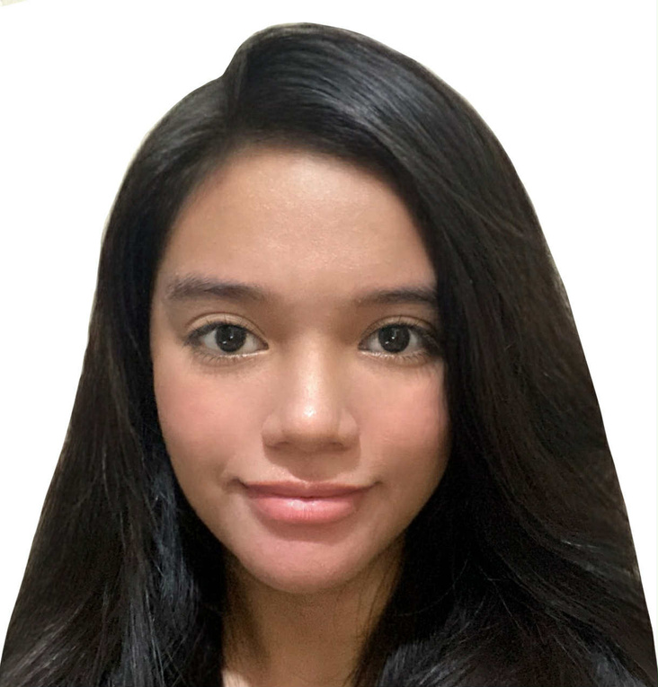


Human Computer Interaction
Members
Eugene Andreu J. Cuello
Izzy Mari C. Monteverde
Jasper B. Ajias

Slide 18

Human Computer Interaction
Thank You

